Slide 1
Caption Generator
Guide Name: Dr. S Thenmozhi Vijaykumar R Pai
Associate Professor, Dept. of CA PES1201702013
PES University

Slide 2
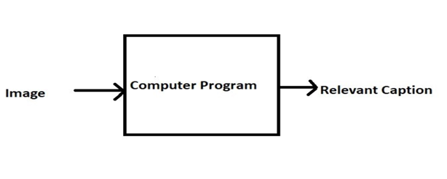
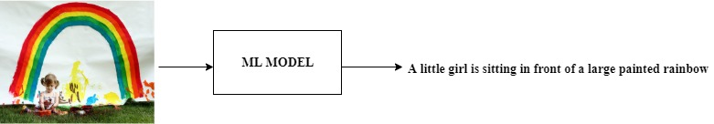
ABSTRACT
Caption Generator is a Machine Learning application which identifies the action portrayed in the given image.
The generated caption will describe about the image which will say what kind of actions is taking place in it.

Slide 3
INTRODUCTION
You saw an image and your brain can easily tell what the image is about, but can a computer tell what the image is representing?
With the advancement in Deep learning techniques and availability of huge datasets and computer power, it is possible to build models that can generate captions for an image.
This project involves Computer Vision and Natural Language Processing concepts to recognize the context of an image and describe them in a natural language like English.
The objective of the project is to build a working model of Caption Generator by implementing CNN with LSTM.
The basic working of the application is that the features are extracted from the images using pre-trained VGG16 model and then fed to the LSTM model along with the captions to train.
The trained model is then capable of generating captions for any images that are fed to it.

Slide 4
LITERATURE SURVEY
Existing Systems
Captionbot.ai
It is a product of Microsoft.
It is a ML application which can understand the content of any image.
When a person upload a photo, it is sent to Microsoft for image analysis to return a caption
The application will not store or publish the images anywhere.
It uses Computer Vision API and Emotion API
How-Old.net
It is also a product of Microsoft.
It estimates the age of the person in the given image.
The age is generated as a caption
TwinsOrNot.net
It identifies whether the image has twins or not

Slide 5

LITERATURE SURVEY
Research Papers
Title: A survey on automatic image caption generation
Author: Shaung Bai, Shan Au
Publication: Science Direct
Summary: In this paper, the images are classified into different categories and later captions are generated which is time consuming.

Slide 6
Title: An Empirical Study of Language CNN for Image Captioning
Author: Jiuxiang Gu, Gang Wang, Jianfei Cai, Tsuhan Chen
Publication: 2017 IEEE International Conference on Computer Vision
Summary: In this paper, effectiveness of their approach is validated on two datasets: Flickr30K and MS COCO. The extensive experimental results show that their method outperforms the vanilla recurrent neural network based language models and is competitive with the state-of-the-art methods.

Slide 7
Title: A Comprehensive survey of Deep Learning for Image Captioning
Author: MD. Zakir Hossain, Ferdous Sohel, Mohd Fairuz Shiratuddin, Hamid Laga
Publication: Murdoch University, Australia
Summary: In this paper, Although deep learning-based image captioning methods have achieved a remarkable progress in recent years, a robust image captioning method that is able to generate high quality captions for nearly all images is yet to be achieved.

Slide 8
Title: Automated Neural Image Caption Generator for Visually Impaired People
Author: Christopher Elamari, Teun de Planque
Publication: Department of Computer Science, Stanford University
Summary: This paper represents a deep recurrent architecture that automatically generates brief explanations of images.

Slide 9
TOOLS AND TECHNOLOGIES
Frontend: HTML, CSS, Bootstrap
Backend: Flask 1.x
Language: Python 3.7
Storage (Dataset): Google Drive
IDE: Jupyter Notebook

Slide 10
Functionalities
User Perspective
User launches the application.
User uploads the images for which the captions are to be generated.
User clicks on the submit button.
Within a matter of seconds, the ML model recognizes and process the content of an image.
The result will be displayed on the page.

Slide 11
Functionalities
Model Development and Deployment
Data Gathering
Images for training the model
Corpus for Image captions
Pre-processing
Corpus – Removal of stop words, punctuation marks, digits
Generating the bag of words
Mapping of images with the Corpus
Feature extraction from images
Object identification
Model Generation using CNN
Building LSTM (Long Short Term Memory) model.
Validating the Model
Deploy the ML model in the web application

Slide 12
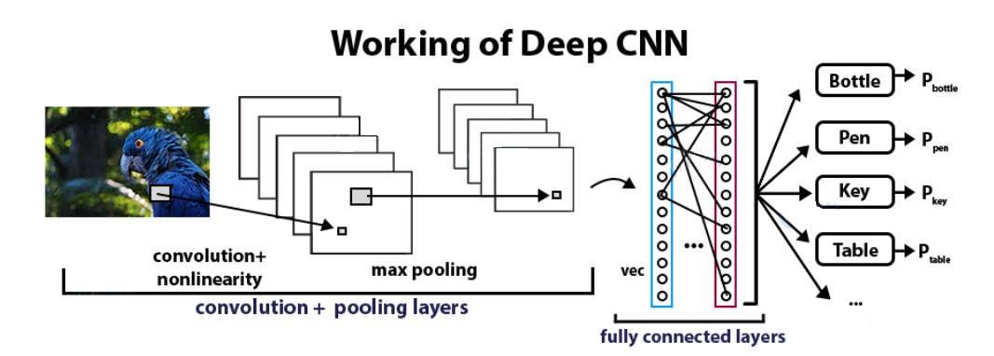
DETAILED METHODOLOGY
1. Convolutional Neural Networks
CNN Algorithm – With the help of CNN Algorithm, features are extracted from the images with the help of pre-trained VGG16 model.
CNN Algorithm is being used in this project as they are specialized deep neural networks which can process the data that has input shape like a 2D matrix. Images are easily represented as a 2D matrix and CNN is very useful in working with images.

Slide 13
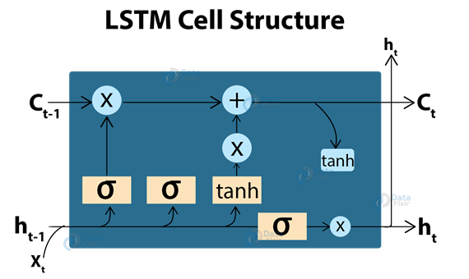
DETAILED METHODOLOGY
2. LSTM (Long Short Term Memory)
LSTM Algorithm – With the features being extracted from the images with the help of CNN Algorithm, they are now fed into the LSTM model which will be responsible for generating the image captions.
LSTM (Long Short Term Memory) is a type of RNN which is well suited for sequence prediction problems. With the help of LSTM, it can predict what the next word will be. LSTM will use the information from CNN to help generate a description of the image.

Slide 14
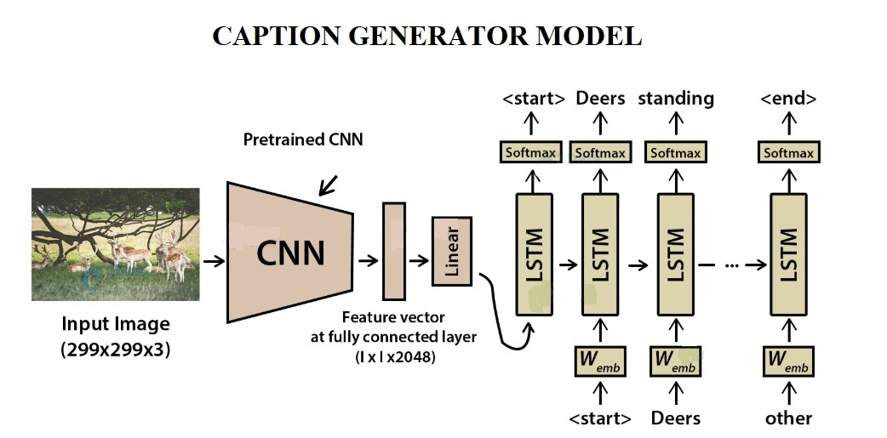
3. Model Generation

Slide 15
APPLICATION IN THE REAL WORLD
If the caption is converted to speech it will be helpful for the visually impaired person
Auto subtitling

Slide 16
Progress
Data Gathering
Flickr_8K dataset – For this project, Flickr_8K dataset is being used as other big datasets like Flickr_30K and MSCOCO datasets can take weeks just to train the network.
Web user interface created
Pre-processing(doing)

Slide 17
THANK YOU

